Slide 1
PRINCIPLES & PRACTICE OF PERIODONTAL MICROSURGERY.
GUIDED BY:
DR. P. SURESH,
PROF & HOD,
DEPARTMENT OF PERIODONTICS.
PRESENTED BY:
DR.K. LATHA

Slide 2
Contents:
Introduction
History
Clinical philosophy
Hand control
Hand grips
Microsurgical triad
Periodontal microsurgery
Conclusion
References

Slide 3
Introduction:
Microsurgery refers to a surgical procedure performed under a microscope.
It is a practice that embraces three distinct values.
First is enhancement of motor skills to improve surgical ability. This is evident in the smooth hand movements accomplished with increased precision and reduced tremor.
Second is the decreased tissue trauma at the surgical site, which is apparent in the use of small instruments and a reduced surgical field.

Slide 4
Third is the application of microsurgical principles to achieve passive and primary wound closure. The aim is the elimination of gaps and dead spaces at the wound edge to circumvent new tissue formation needed to fill surgical voids.
A painful and inflammatory phase of wound healing can then be avoided.

Slide 5
In 1980, microsurgery was described by Serafin as a methodology, a modification and refinement of existing surgical techniques using magnification to improve visualization, with applications to all specialties.
Dentistry has borrowed microsurgery from medical science.

Slide 6
The purpose of this paper is to provide a brief review of what periodontal microsurgery entails: the role of magnification, microsurgical instrumentation and design, the surgeon’s physiologic and physical status, posture, hand positions, knot tying, appropriate applications and the effects of microsurgery on aesthetics.

Slide 7
HISTORY
The history of microsurgery dates from 1922 when Nylen first performed eye surgery under a microscope.
By the 1960s microsurgery was standard in many specialties such as neurology and ophthalmology.
A factor in its acceptance was lessened morbidity associated with smaller wounds.

Slide 8
Apotheker and Jako are given the credit to first introduce the microscope to dentistry in 1978.
Microsurgery has been practiced in endodontics since 1986.
It was introduced to the specialty of periodontics in 1992.

Slide 9
In Periodontics, it was introduced by Shanelec and Tibbetts who presented a continuing education course on periodontal microsurgery at the annual meeting of the American Academy of Periodontology in 1993.

Slide 10
CLINICAL PHILOSOPHY:
As a treatment philosophy, microsurgery incorporates three important principles:
Improvement of motor skills, thereby enhancing surgical ability.
An emphasis on passive wound closure with exact primary apposition of the wound edge.
The application of microsurgical instrumentation and suturing to reduce tissue trauma.

Slide 11
Consistent application of the philosophy and techniques learned in basic microsurgery education is necessary for the operator to attain a level of experience and competence needed for various periodontal surgical procedures.
Becoming a clinically proficient periodontal microsurgery allows the operator to consistently achieve clinical results that were once thought to be unlikely.

Slide 12
Training with the microscope enhances the motor skills, which can translate to improved surgical skills.
The methods of precise, delicate tissue handling, wound closure, and suturing require concentration and practice.
Attention must be paid to micro-anatomy, tissue manipulation, and surgical craftsmanship.

Slide 13
HAND CONTROL:
PHYSIOLOGIC TREMOR
The finger movements controlled by the long flexor and extensor muscles that move our fingers are relatively crude.
Thus, active finger extensions or flexions, are likely to be relatively crude.
When the wrist is stabilized by resting on a flat surface, angled in a dorsiflection position at approximately 20 degrees, more accurate, finely controlled finger movement can be accomplished because of the reduction in muscle tremor provided by this platform.

Slide 14
Physiologic tremor is the uncontrolled movement arising from both the intended and unintended actions of our bodies.
Awareness of its effect is magnified by visual enhancement.

Slide 15
During microsurgery, physiologic tremor manifests as a naturally occurring unwanted hand and finger movement.
To minimize tremors, a micro surgeon must have a relaxed state of mind, good body comfort and posture, a well-supported hand, and a stable instrument – holding position.

Slide 16
Mental focus and patience during the procedure are important factors in maintaining precise motor control skills.
Physiologic tremor is usually associated with tension generated by the postural control “antigravity” muscles – relaxed and proper seating posture is essential.

Slide 17
The surgeon must be seated upright with the legs extending forward and with both feet flat on the floor so that the calf of each leg forms a right angle to the thigh.
Support of the ulnar surface of the forearm and wrist is necessary to control or reduce tremor.
Surgeons head – comfortable upright position.
The hand should either rest directly or indirectly rest on an immovable surface or unwanted movements will occur.

Slide 18
HAND GRIPS
The most commonly used precision grip – pen grip or internal precision grip.
The thumb and index and middle fingers are used as a tripod.
The forearm – slight supine & knuckles away from you.

Slide 19
The middle finger – rest firmly & directly on the working surface supporting the hand or indirectly on the ring finger.
Any tremors caused in the thumb or index finger is minimized by the contact with the supported , steady middle finger.

Slide 20
The microsurgeon’s position relative to the patient is an important consideration.
The most precise rotary suturing movement for a right-handed person is from 2 o’clock to the 7o’clock position, while most precise movement for left-handed people is from 10 o’clock to the 4 o’clock position.

Slide 21
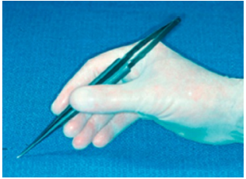

Slide 22
MICROSURGICAL TRIAD
The concept of microsurgery is based on three elements which form the microsurgical triad that includes magnification, illumination and instrumentation
Without anyone of these microsurgery is not possible.

Slide 23
MAGNIFICATION
Visual acuity is the ability to perceive two closely lying objects separately.
Visualization of fine details can be enhanced by increasing the image size of the object.
Dentist have a wide range of simple and complex magnifying systems that are available, including three types of magnification loupes and the operating microscope.
The mode of magnification used is often based on the task to be accomplished & operator’s experience level.

Slide 24
Dental loupes are the most common system of optical magnification.
They are fundamentally dual monocular telescopes with side-by-side lenses convergent to focus on the operative field.
The magnified image formed has stereoscopic properties by virtue of their convergence.
A convergent lens optical system is called a Keplerian optical system.

Slide 25
Although being less expensive and cumbersome, dental loupes are widely used but they have disadvantages compared with the microscope.
The clinician's eyes must converge to view the operative field which can result in eyestrain, fatigue, and even pathologic vision changes; especially after prolonged use.

Slide 26
Three types of Keplerian loupes are typically used in periodontics:
simple or single-element loupes,
compound loupes, and
prism telescopic loupes.

Slide 27
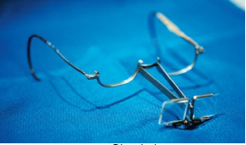
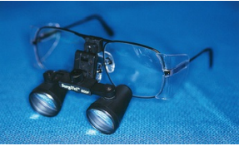
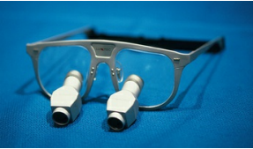

Slide 28
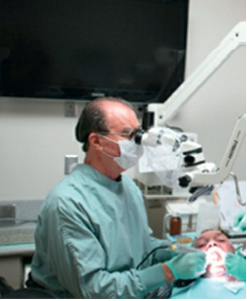
Operating microscope

Slide 29
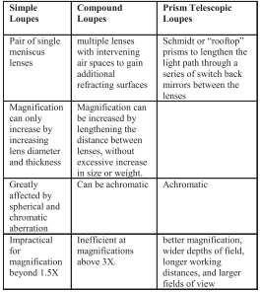

Slide 30
LOUPES VERSUS OPERATING MICROSCOPE:
There are few advantages and disadvantages to each system.
Loupes are less expensive and initially easier to use.
They are also less cumbersome in the operating field and less likely to breech a clean operating field.
Both loupes and microscope improve visual acuity and ergonomic comfort and efficiency by increasing the working distance.

Slide 31
When dentists assume a working distance of 13 inches or less to the patient without magnification or with ill-fitted loupes, a multitude of eye, neck, shoulder, and back problems become increasingly evident with age.
Such problems may be reduced or eliminated by using magnification.
A 6 to 8 inch increase in normal working distance has been shown to vastly improve postural ergonomics and reduce eyestrain in industrial workers.

Slide 32
The advantages of the operating microscope include its versatility due to an extended range of variable magnification from 2.5x to 20x and to excellent coaxial fiber-optic, shadow-free illumination.
An additional advantage is the availability of numerous accessories for digital still and video image case documentation.
The greatest advantage, however, is increased operator eye comfort due to the parallel viewing optics provided by Galilean system.

Slide 33
The limitations of loupes include fixed magnification or a lack of magnification variability and the potential need for additional light for magnification levels of 4.0x or greater.
Loupes with larger field of view have brighter illumination & the brighter images than those with narrow field of view.

Slide 34
After using magnification loupes and the surgical microscopes for over a decade and half, the authors find that the use of the microscope offers many advantages over loupes.

Slide 35
Although magnification makes microsurgery possible, there are also drawbacks, including:
A restricted area of vision and loss of depth of field as magnification increases,
Loss of visual reference points,
Extra time needed to develop an experienced team approach for planning & practice to avoid errors in positioning instruments & placement of sutures.
Accentuated physiologic tremors that must be controlled for fine movements,
A steep learning curve. Different magnifications are appropriate for various stages of a procedure.

Slide 36
ILLUMINATION
Most of the manufacturers offer collateral lighting systems which are helpful, particularly for higher magnification in the range of 4X and more.
Considerations to be made in the selection of an accessory lighting source.
1. Total weight, quality, and brightness of the light.
2. Ease of focusing and directing the light within the field of view.
3. Ease of transport between surgeries.

Slide 37
MICROSURGICAL INSTRUMENTS
Using conventional instruments in microsurgery is not really an option as their size implies a larger surgical access, which goes against the whole concept of microsurgery.
So microsurgical instruments are the third element of microsurgical triad.

Slide 38
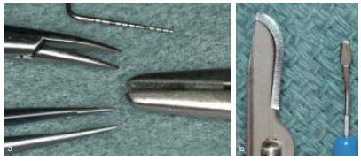

Slide 39
Rationale in favour of microsurgical instruments:
As the inflammation, edema, post- operative pain, and the healing time are increased with larger spread of the soft and hard tissues included in the manipulation ,limiting the extent of the surgical site reduces morbidity.
Tissues suffer more from crushing than incisions or puncture.
The edginess of ophthalmic surgical blades is obtained by electrolytic process and not machined.

Slide 40
So, the blade edges are sharper, and the surface texture of the blade is smoother, resulting in a perfect incision leading to least possible trauma.
Blunt instruments crush the fragile tissues, potentially inducing necrosis, while the forceps with microscopic teeth allows the operator to delicately reposition the soft tissues.

Slide 41
Risk of necrotic zones and its related aesthetics and functional consequences are more if the blood supply to the tissues handled is compromised.
Certain incisions are altogether avoided, using a microscope contributing to a better blood perfusion of the tissues.

Slide 42
SUTURES
One of the three basic premises of microsurgery is attention to passive wound closure.
The incisions should be almost invisible & closed with precisely placed, small sutures with minimal tissue damage and no bleeding.
The criteria necessary for successful use of suture materials are dependent on the surgical procedure to be performed & the factors necessary to successfully close the wound in a manner that promotes optimum healing.

Slide 43
The smaller the suture material & needle used to pass through the tissue, the less trauma will result.
Most periodontal microsurgical suturing is done with sutures ranging in size from 6-0 to 9-0.

Slide 44
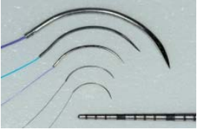

Slide 45
SUTURE NEEDLE
Microsurgery uses needles of fine gauge material that are very small.
They are designed for maximum needle holder stability.
Needle holder performance has a significant impact on the entire suturing procedure.
The needle holder must be appropriately sized for the needle and suture selected.

Slide 46
SUTURE GEOMETRY:
The geometry of microsurgical suturing consists of the following:
Needle angle of entry and exit of slightly less than 90 degrees.
Suture bite size of approximately 1.5 times the tissue thickness.
Equal bite sizes (symmetry) on both sides of the wound.
Needle passage perpendicular to the wound.

Slide 47
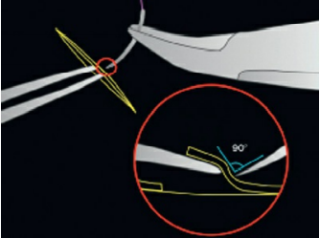
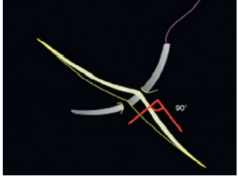
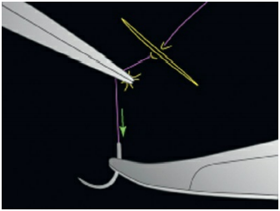

Slide 48
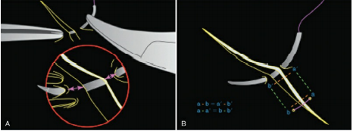

Slide 49
KNOT TYING:
Suturing is critical factor in periodontal treatment success.
Knot tying using microscope is done in using instrument ties, with the microsurgical needle holder in the dominant hand and a microsurgical tissue pick-up in the non dominant hand.
Only the working tips of the instruments are visible in the microscopic field.

Slide 50
PERIODONTAL MICROSURGERY
Clinical expertise beyond the range of visual acuity is needed in
periodontal plastic surgery,
guided tissue regeneration,
crown lengthening,
ridge augmentation,
implant placement etc.
So microsurgery is very important in Periodontics.

Slide 51
ESTHETIC SURGICAL PROCEDURES
Periodontal plastic surgery is “technique-sensitive” and more demanding than other periodontal procedures.
Microsurgery has wide implications including the rotational, free gingival, double papilla, and the sub-epithelial connective tissue grafts for the coverage since it causes minimal trauma and enhances the wound healing process.

Slide 52
The combination of small microsurgical instruments and delicate surgical techniques allow for extremely fine, crisp and accurate incisions, gentle tissue handling, and precise suturing.

Slide 53
ROOT COVERAGE PROCEDURES
Accurate diagnosis with microsurgical techniques makes complete root coverage extremely predictable in Class I and Class II marginal tissue recessions.
Partial root coverage results achieved in Class III & Class IV marginal recession with conventional surgery can also be greatly enhanced through the use of microsurgery.

Slide 54
According to studies, the use of microsurgical technique depicted a greater increase in width of keratinized tissue and thickness of keratinized tissue as compared to the macro- surgical techniques performed.

Slide 55
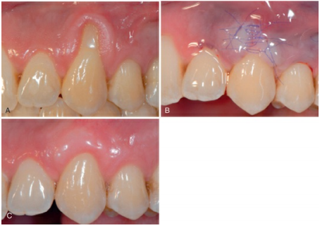

Slide 56
PAPILLA RECONSTRUCTION
Apart from the various root coverage procedures performed other mucogingival surgeries like papilla reconstructions and ridge augmentation around natural teeth and implants can also be carried out.

Slide 57
ROOT SURFACE CONDITIONING:
Since root surface preparation addresses how the soft tissue attaches to the root of the tooth in root coverage surgery, it is of the utmost importance.
In an attempt to get new periodontal ligament attachment of a graft to the tooth with new cementum and Sharpey's fibers, several methods of root preparation have been suggested including mechanical root preparation, chemical root preparation, and biologic root preparation.

Slide 58
CONCLUSION
PERIODONTAL MICROSURGERY has many applications and benefits.
It is a technique sensitive, but it results in more rapid healing because it is less invasive and less traumatic.
Improved visual acuity ergonomics .
It provides a natural evolution in the progression of periodontics.

Slide 59
REFERENCES
Caranza’s Clinical Periodontology – 13th edition.
Lang N P, Lindhe J: Clinical Periodontology and Implant Dentistry- 6th edition.
Shanelec DA. Periodontal Microsurgery. J Esthet Restor Dent 15:402-408, 2003.
Kang K K, Grover D, Goel V, Kaushal S, Kaur G. PERIODONTAL MICROSURGERY AND MICROSURGICAL INSTRUMENTATION: A REVIEW. DJAS 4(11), 74-80, 2016.

